Slide 1

HOSPITAL MANAGEMENT SYSTEM
Cardiology Department

Slide 2

INTRODUCTION
This project represents a specialized Cardiology Management System within a broader Hospital Management framework. It involves designing a structured database using ER modeling, normalization, and SQL to efficiently manage heart-related patient care and administrative operations. Focusing on cardiology helps narrow the scope and streamline system development.

Slide 3
OBJECTIVES:
To track and manage patients, cardiologists (doctors), appointments, diagnostic tests, treatments, medications, procedures, admissions, payments, wards, and nurses.
To improve efficiency, traceability, and accuracy in handling cardiology-specific workflows.
To ensure data normalization, integrity, and relational structure for effective querying and reporting.

Slide 4
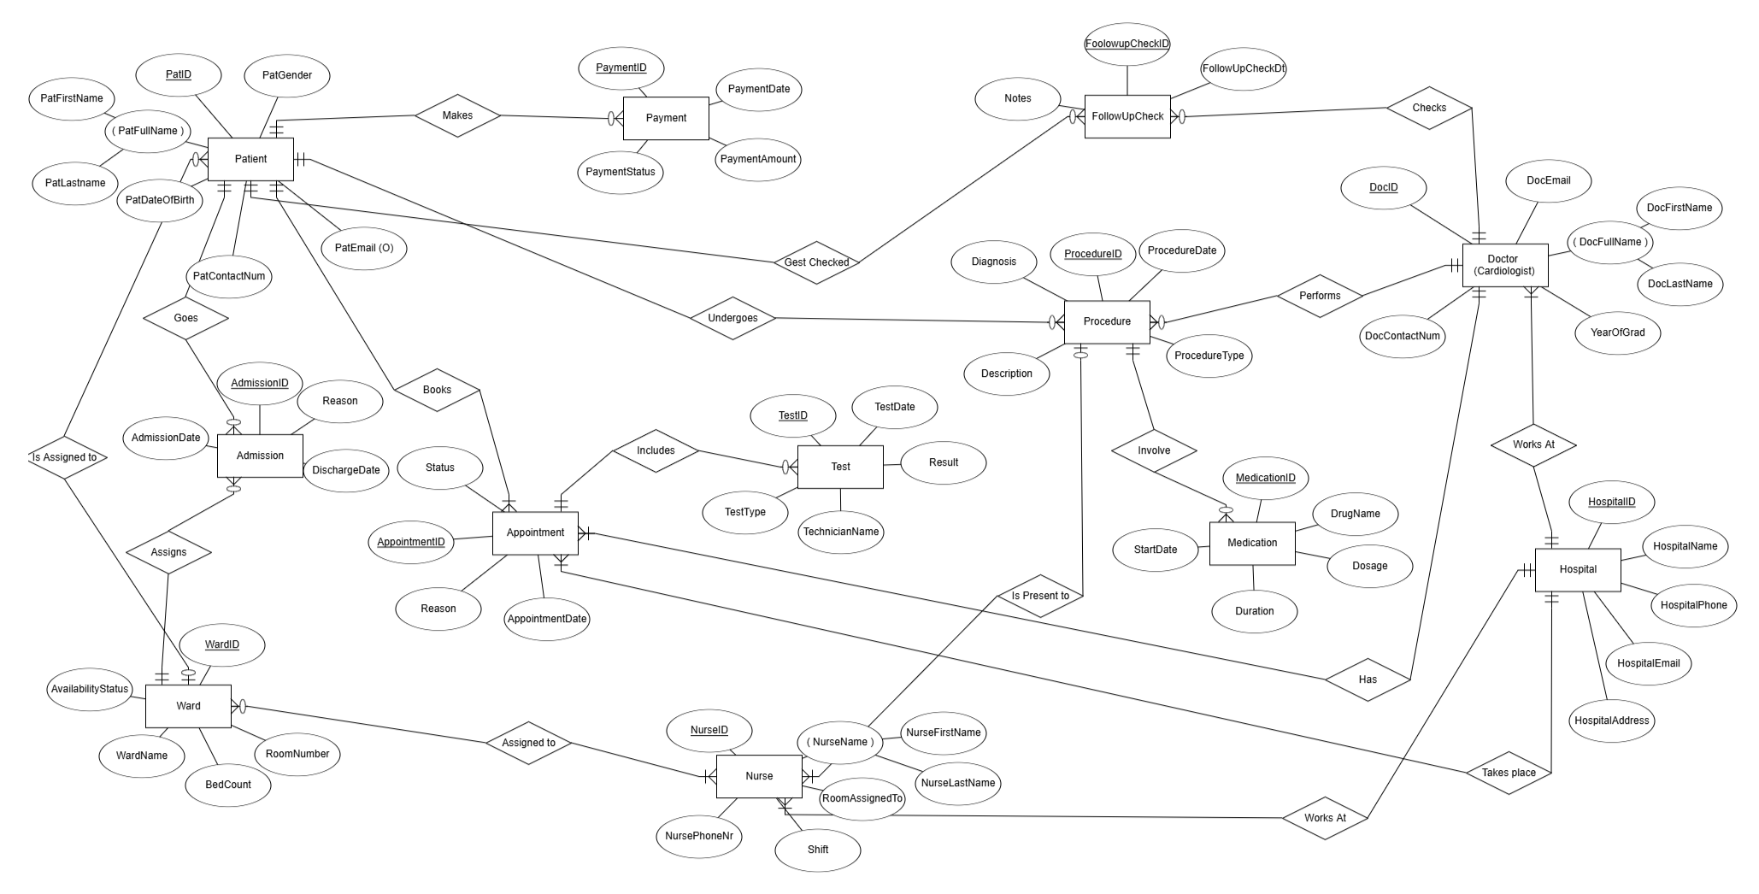
ER Diagram

Slide 5
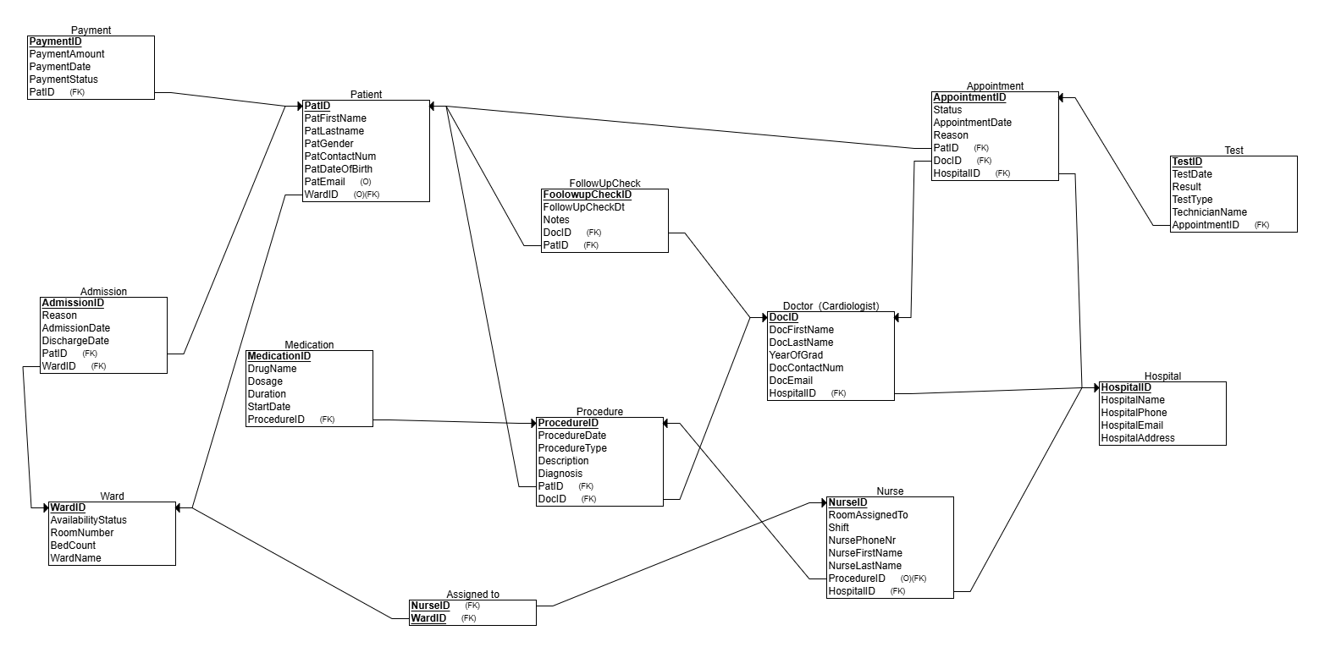
Relational Schema

Slide 6
CREATION OF TABLES Patient
PatID | PatFirstName | PatLastName | PatGender | PatContactNum | PatDtOfBirth | PatEmail | WardID
01 | Emily | Johnson | F | 1467800325 | 2000-10-26 | emily@gmail.com | 1
02 | John | Williams | M | 3689022002 | 1993-05-29 | john@gmail.com | 2
03 | Tom | Wilson | M | 0975541903 | 1985-06-21 | tom@gmail.com | 3
04 | Jane | White | F | 1579301957 | 1997-11-07 | jane@gmail.com
05 | Jackson | Roberts | M | 7893567723 | 1966-07-29 | jackson@gmail.com
06 | Olivia | Scott | F | 9088845230 | 1973-11-27 | olivia@gmail.com | 5

Slide 7
Hospital
HospitalID | HospitalName | HospitalPhone | HospitalEmail | HospitalAdd
1 | Cardio Health Center | 555-1234 | info@cardiohc.org | 123 Heart Lane
Doctor
DocID | DocFirstName | DocLastName | YearOfGrad | D.ContactNum | D.Email | HospitalID
AA | Emma | Yang | 2008 | 2000000000 | emma1@hospital.org | 1
AB | Gregory | Bailey | 2010 | 2000000001 | gregory1@hospital.org | 1
BB | Alex | James | 1993 | 2000000002 | alex1@hospital.org | 1
BC | Cristina | Grey | 2015 | 2000000003 | cristina1@hospital.org | 1

Slide 8
Follow-up-check
FollowupcheckID | FollowupcheckDate | Notes | DocID | PatID
1 | 2025-02-14 | Patient improving | AA | 01
2 | 2025-04-09 | Blood pressure stable | BB | 03
3 | 2025-05-02 | Further test advised | BC | 05
4 | 2025-04-21 | No complications | AA | 02
5 | 2025-05-03 | ECG clear,no arrhythmia | AA | 02
6 | 2025-02-12 | MRI next week | BB | 03

Slide 9
Payment
PaymentID | Payment Amount | PaymentDate | Payment Status | PatID
0 | 350.75 | 2025-03-25 | Paid | 02
1 | 500.00 | 2025-01-03 | Paid | 03
2 | 450.00 | 2025-02-22 | Pending | 03
3 | 530.20 | 2024-09-01 | Declined | 04
4 | 475.00 | 2025-02-16 | Pending | 06
5 | 200.00 | 2024-10-11 | Paid | 01
6 | 370.00 | 2025-01-24 | Paid | 03
7 | 190.00 | 2025-04-14 | Pending | 05
8 | 250.00 | 2025-03-27 | Paid | 02

Slide 10
Ward
WardID | AvailabilitySt. | RoomNumber | BedCount | WardName
1 | Occupied | 101 | 3 | Ward-1
2 | Available | 102 | 4 | Ward-2
3 | Available | 103 | 2 | Ward-3
4 | Occupied | 104 | 5 | Ward-4
5 | Occupied | 105 | 2 | Ward-5
6 | Available | 106 | 6 | Ward-6
Nurse
Assigned to
NurseID | WardID
N1 | 3
N2 | 6
N3 | 2
N4 | 1
N5 | 3
NurseID | N.FirstName | N.LastName | RoomAssignedto | N.PhoneNr | Shift | ProcedureID | HospitalID
N1 | Daniel | Brown | 101A | 3000000000 | Day | P3 | 1
N2 | Anna | Swift | 101A | 3000000001 | Night | P6 | 1
N3 | Eva | Clark | 102B | 3000000002 | Night | P4 | 1
N4 | Sue | Johnson | 103C | 3000000003 | Day | P1 | 1
N5 | Tina | Smith | 102B | 3000000004 | Day | P2 | 1

Slide 11
Procedure
ProcedureID | ProcedureDate | ProcedureType | Description | Diagnosis | PatID | DocID
P1 | 2024-11-20 | Coronary Angioplasty | Widening narrowed heart arteries | Coronary Artery Disease | 03 | AA
P2 | 2024-10-05 | Pacemaker insertion | Implant for arrhythmia control | Bradycardia | 01 | BC
P3 | 2025-03-11 | Echocardiography | Imaging for valve assesment | Valve Disease | 02 | BB
P4 | 2024-07-15 | Cardioversion | Restoring normal rhythm | Atrial Fibrillation | 04 | BC
P5 | 2025-04-27 | Cardiac Catheterization | Diagnostic catheterization | Chest pain | 05 | AB
P6 | 2025-02-08 | Holter Monitoring | 24-hour ECG monitoring | Palpitations | 06 | AA

Slide 12
Medication
MedicationID | DrugName | Dosage | DurationDays | StartDate | ProcedureID
M0 | Aspirin | 75 mg | 14 | 2024-11-23 | P1
M1 | Isoprotenerol | 10 mg | 12 | 2024-10-08 | P2
M2 | Apixaban | 15 mg | 15 | 2024-07-18 | P4
M3 | Nitroglycerin | 20 mg | 7 | 2025-04-30 | P5
M4 | Propranorol | 40 mg | 10 | 2025-02-10 | P6

Slide 13
Appointment
AppointmentID | Status | Reason | AppointmentDate | PatID | DocID | HospitalID
A000 | Scheduled | Routine check | 2024-09-20 | 01 | AA | 1
A001 | Scheduled | Follow-up | 2025-01-17 | 03 | AB | 1
A010 | Completed | Initial Consult | 2025-01-05 | 03 | AB | 1
A011 | Cancelled | Follow-up | 2025-05-01 | 02 | BC | 1
A100 | Completed | Routine check | 2024-10-25 | 04 | BB | 1
A101 | Completed | Routine check | 2025-03-13 | 05 | AB | 1
A110 | Scheduled | Initial consult | 2025-04-19 | 06 | BB | 1
A111 | Completed | Routine check | 2025-02-16 | 06 | AA | 1

Slide 14
Test
TestID | TestDate | Result | TestType | TechnicianName | AppointmentID
T1 | 2025-02-01 | AbNormal | ECG | Tom Hardy | A001
T2 | 2024-09-29 | Normal | Echocardiogram | Sara Finn | A000
T3 | 2024-11-01 | Abnormal | Stress Test | Sara Finn | A100
T4 | 2025-03-16 | Abnormal | Cardiac MRI | Liam Brooks | A101
T5 | 2025-04-23 | Normal | ECG | Tom Hardy | A110
T6 | 2025-02-20 | Normal | Chest X-ray | Sara Finn | A111

Slide 15
Admission
AdmissionID | Reason | AdmissionDate | Discharge Date | PatID | WardID
1 | Irregular heartbeat | 2024-08-17 | 2024-11-22 | 01 | 1
2 | Chest pain | 2024-04-13 | 2024-06-24 | 05 | 2
3 | Palpitations | 2025-03-08 | 2025-05-11 | 06 | 2
4 | Uncontrolled hypertension | 2025-04-01 | 2025-05-14 | 02 | 4
5 | Irregular heartbeat | 2024-09-21 | 2024-12-19 | 03 | 5
6 | Abnormal ECG findings | 2025-02-16 | 2025-04-28 | 04 | 3

Slide 16
Database Improvement-Normalization
We focused on normalization to enhance the structure and performance of our database system.
It applies a series of normal forms (1NF, 2NF, 3NF), each with progressively more refined rules for organizing data.
1NF
2NF
3NF
Each table must have unique rows, and every column must contain only single, atomic values—no multiple or repeating values allowed.
For a relational table, the process of normalization starts by examining if a relational table is in 2NF.A table is in 2NF if it is in 1NF and if it does not contain partial functional dependencies.
A table is in 3NF if it is in 2NF and if it does not contain transitive functional key dependencies.

Slide 17
Why this matters? 1.Faster performance: Well-structured tables reduce data repetition, leading to quicker query execution and optimized storage. 2.Improved consistency: By minimizing redundancy, normalization ensures that each piece of information is stored in one place, reducing the risk of conflicting data. 3.Easier maintenance: With clear relationships and cleaner design, it's simpler to update, extend, or troubleshoot the database as the system grows.

Slide 18
1)Payment table
PaymentID | PaymentAmount | PaymentDate | PaymentStatus | PatID
1NF-> Unique rows , ro repeated values . Already in 1NF form
2NF ->No Partial key dependencies . Already in that form
3NF->No Transitive key dependecies . Already in that form
2)Admission table
AdmissionID | Reason | Admissiondate | DischargeDate | PatID | WardID
1NF->Unique rows, no repeated values. Already in that form
2NF-> No PKD . Already in that form .
3NF-> No TKD . Already in that form .

Slide 19
3)Ward table
WardID | AvailibilTyStatus | RoomNum | BedCount | WardName
1NF-> Unique Rows. Already in that form
2NF->No partial Key Dependency
1)
WardID | WardName
FKD
2)
WardID | AvailibilityStatus | RoomNum | BedCount
FKD
3NF-> No TKD . Already in that form

Slide 20
4) Medication Table
MedicationID | DrugName | Dosage | Duration | StartDate | Procedure
1NF-> Unique rows . Already in that form.
2NF->No PKD
MedicationID | DrugName
FKD
MedicationID | Dosage | Duration | StartDate | Procedure
FKD
3NF-> No TKD . Already in that form

Slide 21
5)Patient table
PatientID | PatFName | PatLName | Gender | Contact | DateofBirth | WardID
1NF-> Unique row . No repeated values .Already in that form
2NF->No PKD
1)
PatID | PatFName | PatLName
FKD
2)
PatID | PatGender | PatContactNum | PatDateOfBirth | PatEmail | WardID
FKD

Slide 22
6)FollowUpCheck table
FollowUpCheckID | Date | Notes | DoctorID | PatientID
FKD
1NF-> Unique values . Already in that form
2NF->No PKD. Alreadyn in that form
3NF-> No TKD . Already in that form
7)Procedure table
ProcedureID | ProcedureDate | ProcedureType | Description | Diagnosis | PatID | DocID
FKD
1NF->Unique rows. Already in that form
2NF->No PKD. Already in that form
3NF->No TKD. Already in that form

Slide 23
8)Nurse table
NurseID | NurseFName | NurseLName | PhoneNum | RoomAssignedTo | Shift | ProcedureID | HospitalID
1NF-> Unique values
2NF-> No PKD
1)
NurseID | NurseFName | NurseLName
FKD
2)
NurseID | PhoneNum | RoomAssignedTo | Shift | ProcedureID | HospitalID
FKD

Slide 24
9)Assigned to table
NurseID | WardID
FKD
1ND->Unique values . Already in that form
2NF->No PKD . Already in that form
3NF-> No TKD. Already in that form

Slide 25
10)Doctor Table
DocID | DocFName | DocLName | YearOfGrad | ContackNum | Email | HospitalID
1NF-> Unique Values . Already in that form
2NF->No PKD
1)
DocID | DocFName | DocLName
FKD
2)
DoctorID | YearOFGrad | Contact | Email | HospitalID
FKD
3NF->No TKD. Already in that form

Slide 26
11)Appointment table
AppointmentID | Status | AppointmentDate | Reason | PatID | DocID | HospitalID
FKD
1NF->Unique Rows.Already in taht state
2NF-> No PKD. Already in that state
3NF-> No TKD. Already in that state

Slide 27
12)Hospital table
HospitalID | HospitalName | HospitalPhoneNum | HospitalEmail | HospitalAdress
1NF-> Unique values. Already in that form
2NF-> No PKD .
1)
HospitalID | HospitalName
FKD
2)
HospitalID | HospitalPHoneNum | HospitalEmail | HospitalAdress
FKD
3NF->Nn TKD . Already in that form

Slide 28
13)Test table
TestID | TestDate | Result | TestType | TechName | AppointmentID
1NF->Unique values. Already in that form
2NF->
1)
TestID | TestType
FKD
2)
TestID | TestDate | Result | TechType | AppointmentID
FKD
3NF-> No TKD . Already in that form

Slide 29
SQL Code Implementation
CREATE & INSERT DATA
CREATE TABLE patient
( patid CHAR(2) NOT NULL,
patfirstname VARCHAR(12) NOT NULL,
patlastname VARCHAR(12) NOT NULL,
patgender CHAR(1) NOT NULL,
patcontactnum VARCHAR(10) NOT NULL,
patdtofbirth DATE NOT NULL,
patemail VARCHAR(20) NOT NULL,
wardid CHAR(1),
PRIMARY KEY (patid),
FOREIGN KEY (wardid) REFERENCES ward(wardid) ) ;
INSERT INTO patient VALUES ('01','Emily','Johnson','F','1467800325','2000-10-26','emily@gmail.com','1');
INSERT INTO patient VALUES ('02','John','Williams','M','3689022002','1993-05-29','john@gmail.com','2');
INSERT INTO patient VALUES ('03','Tom','Wilson','M','0975541903','1985-06-21','tom@gmail.com','3');
INSERT INTO patient VALUES ('04','Jane','White','F','1579301957','1997-11-07','jane@gmail.com',NULL);
INSERT INTO patient VALUES ('05','Jackson','Roberts','M','7893567723','1966-07-29','jackson@gmail.com',NULL);
INSERT INTO patient VALUES ('06','Olivia','Scott','F','9088845230','1973-11-27','olivia@gmail.com',5);
Full SQL code is provided in the project documentation.

Slide 30
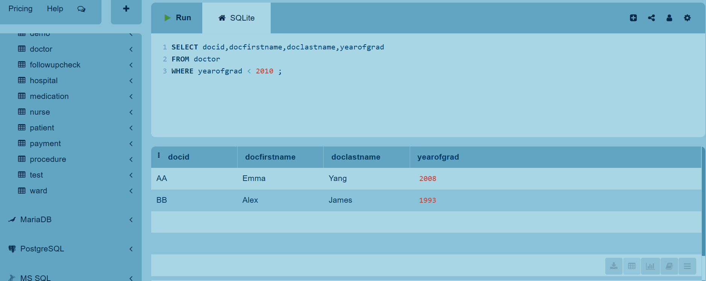
Managerial Queries
1.Retrieve the doc id,doc firstname,doc lastname,year of graduation for the doctors who graduated before the year 2010

Slide 31
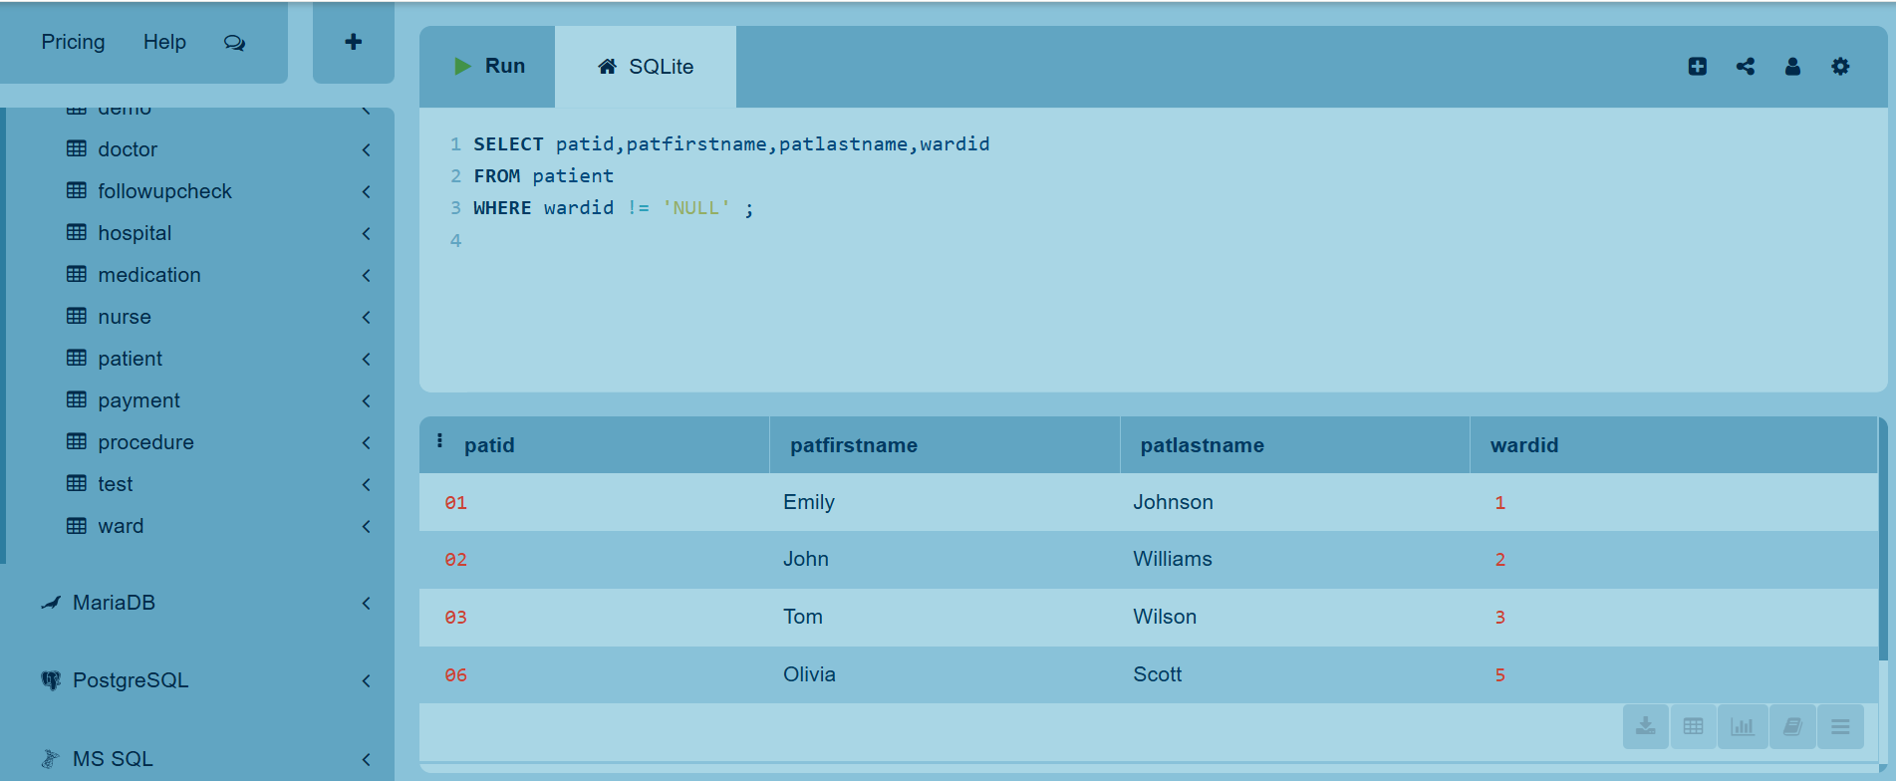
2.Retrieve pat id,pat firstname,pat lastname,ward id to list all patients with their assigned ward

Slide 32
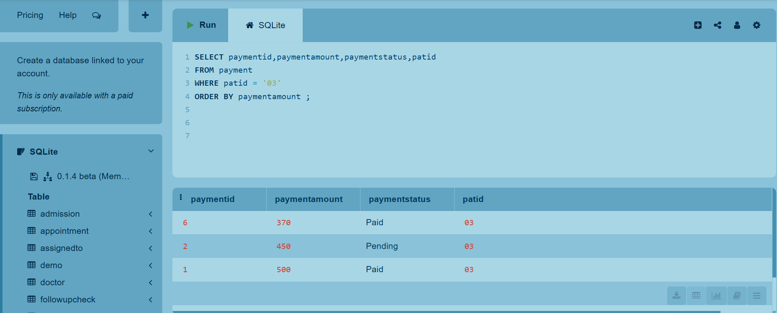
3.Retrieve paymentid,payment amount,payment status,pat id for each patient with ID 03,sorted by payment amount

Slide 33
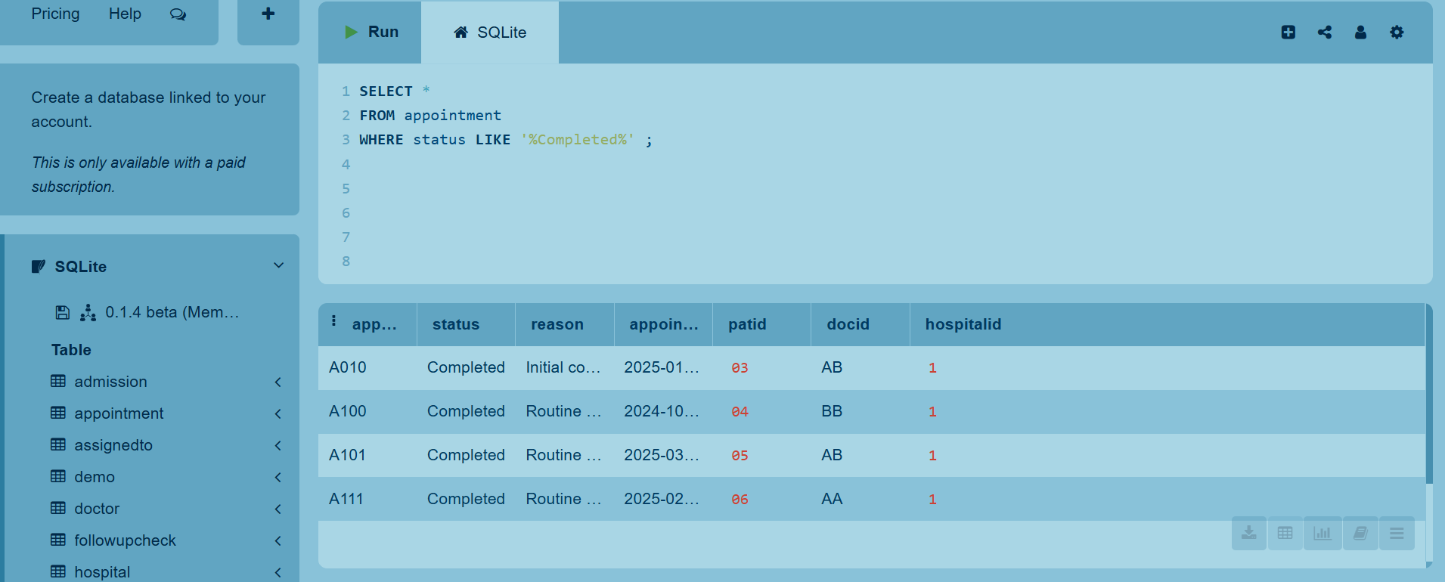
4.Retrieve the record for each appointment whose status contains the phrase 'Completed'

Slide 34
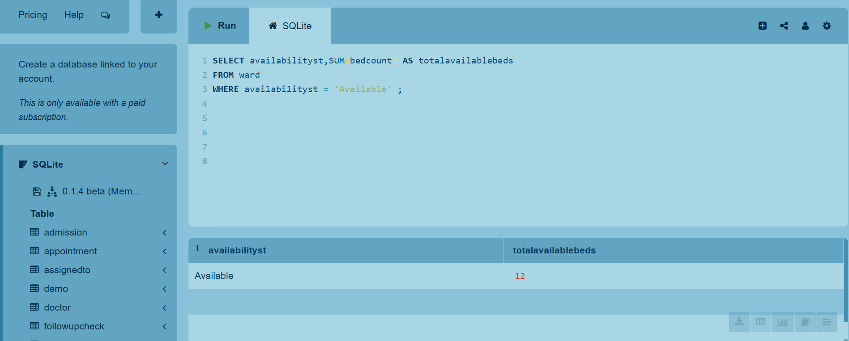
5.Retrieve the total number of beds in available wards

Slide 35
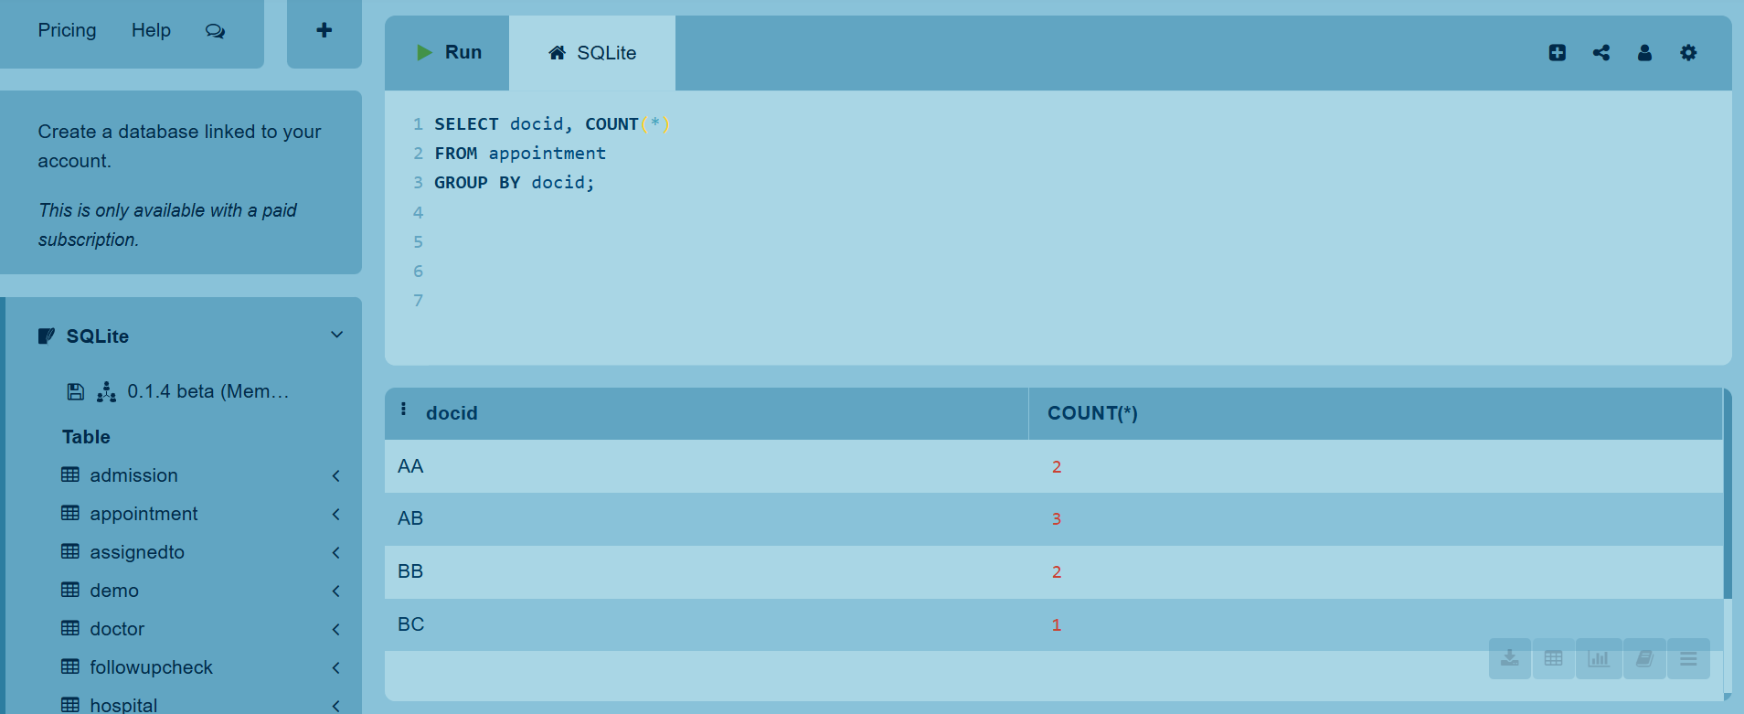
6.For each doctor,retreive the doc id,number of appointments supplied by the doctor

Slide 36
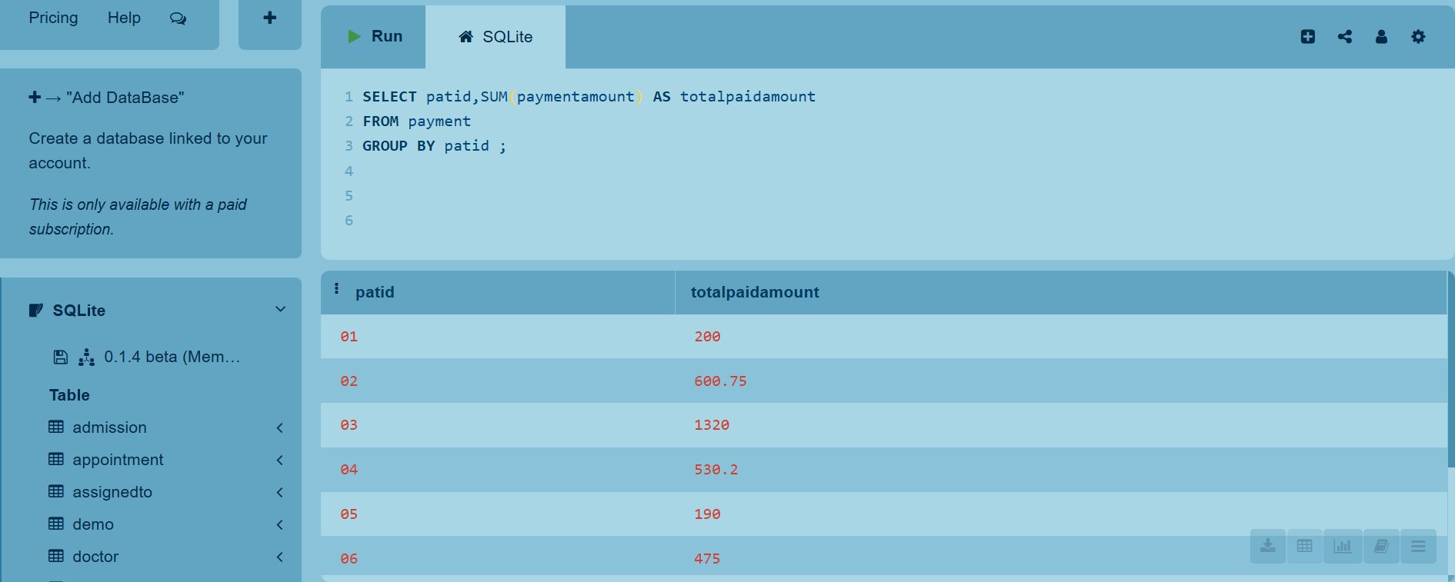
7.For each patient,retrieve the pat id and the total payment amount for each patient

Slide 37
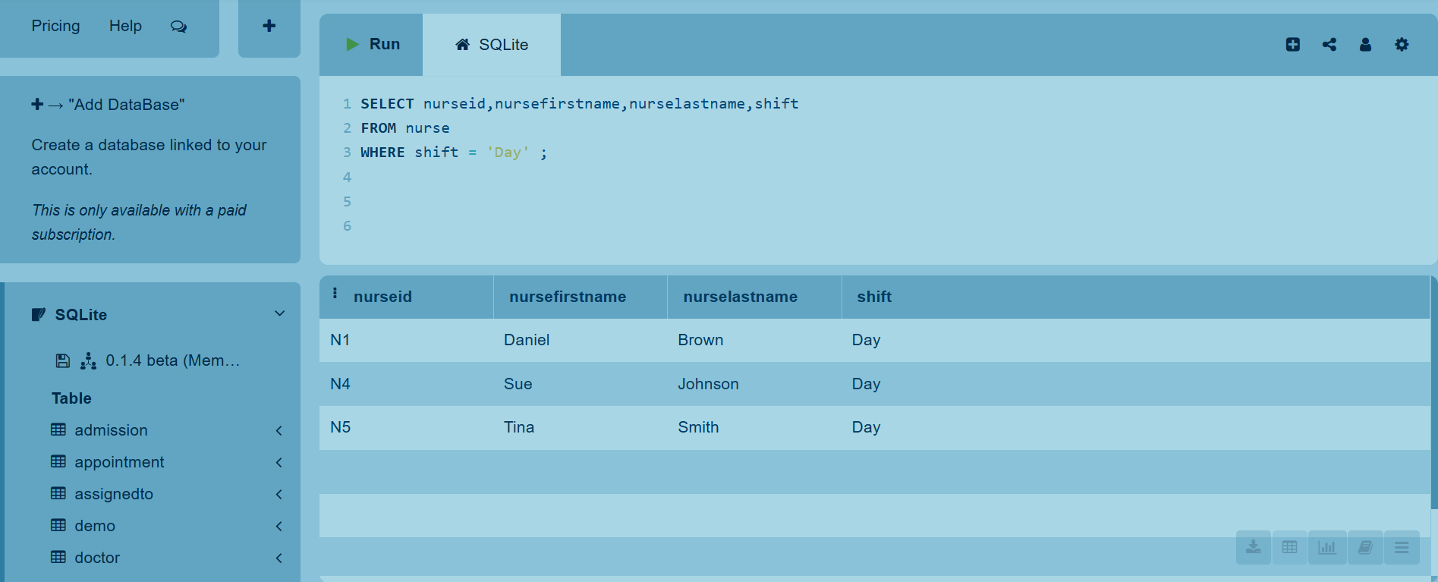
8.List all the shift day nurses

Slide 38
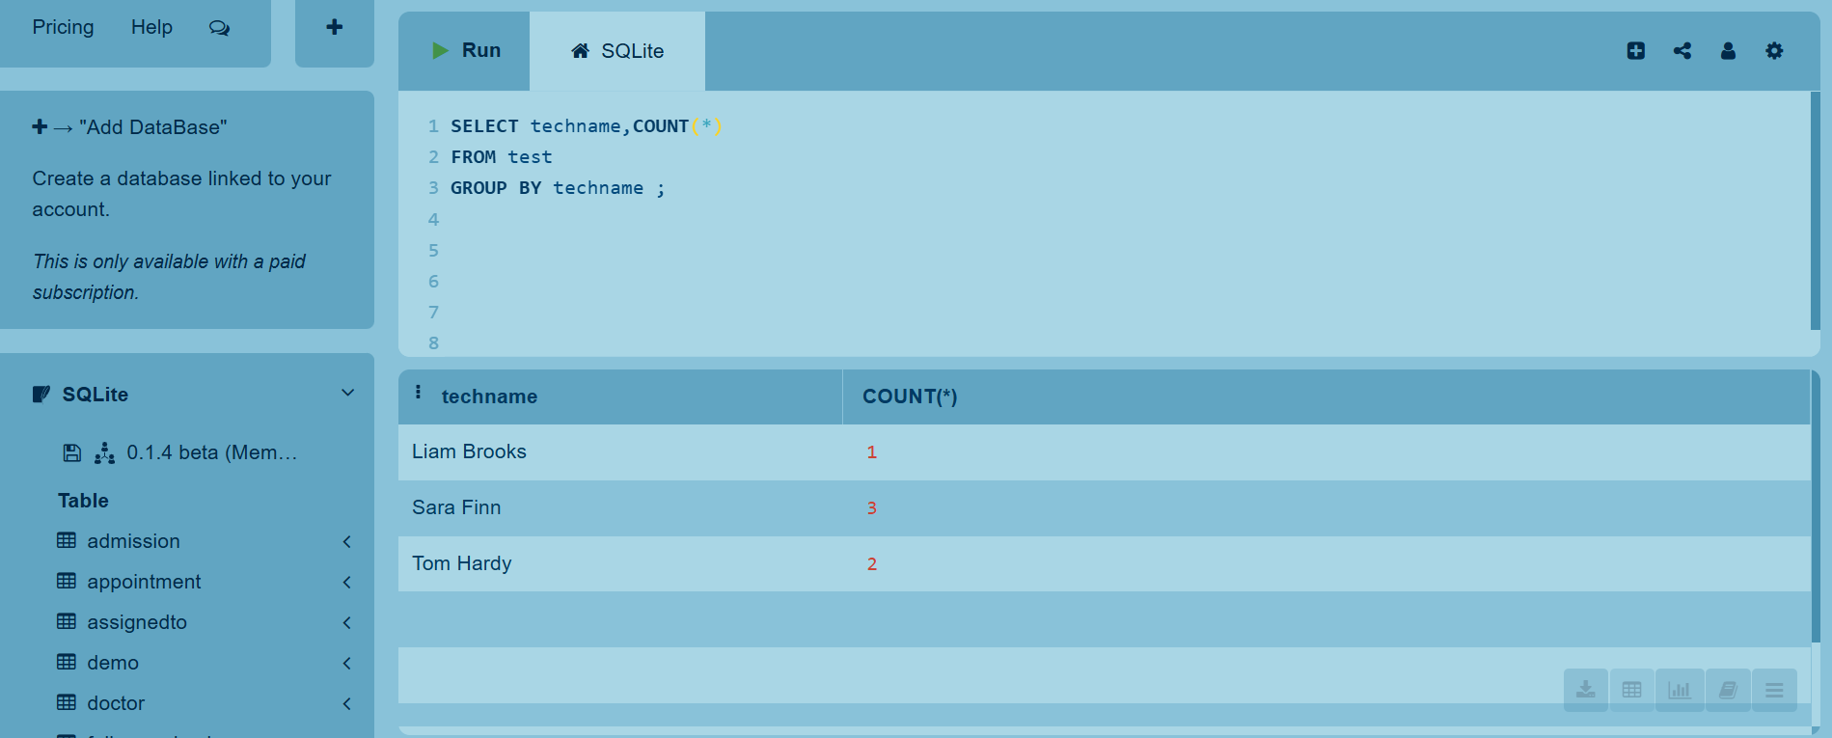
9.For each technician count how many tests are performed

Slide 39
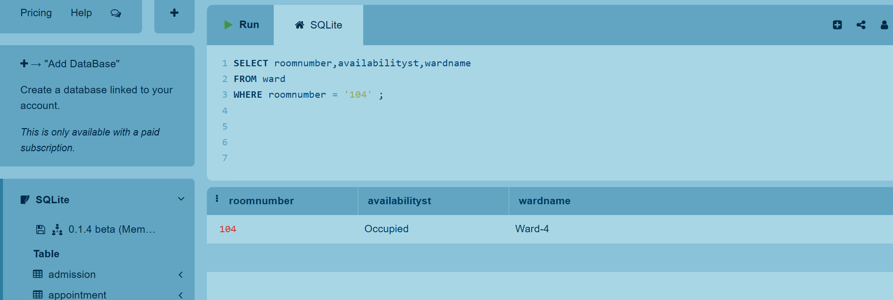
10.Retrieve the room number,availability status and ward name for the room with number '104'

Slide 40
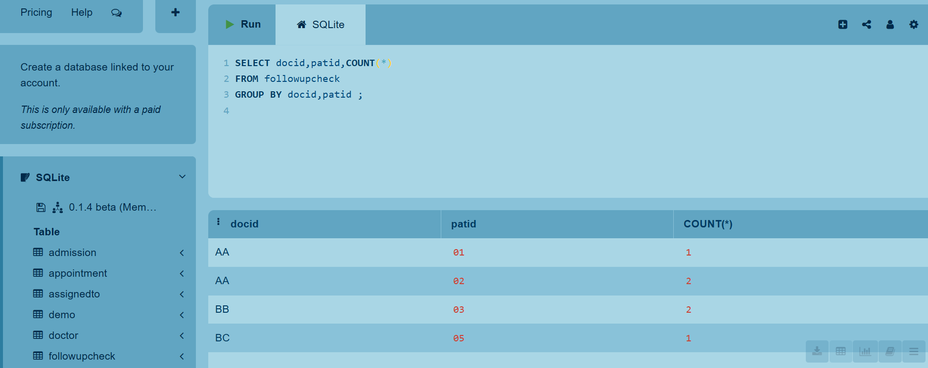
11.Consider the groups of followupcheck where each group contains the followupchecks that are from the same patients supplied by the same doctor.For each group retrieve the doc id,pat id and number of followupchecks in the group

Slide 41
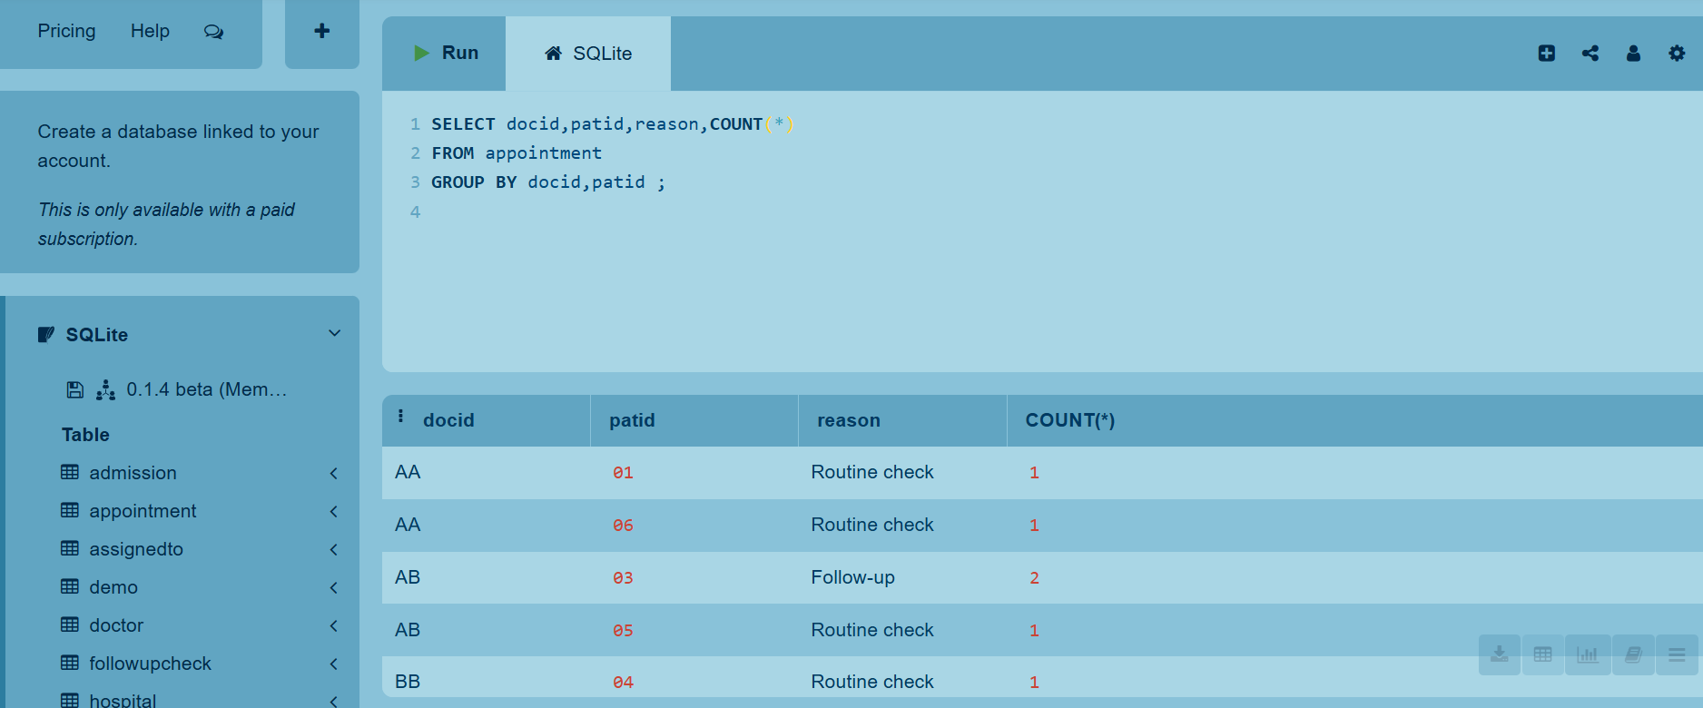
12.Consider the groups of appointment where each group contains the appointments that are from the same patients supplied by the same doctor.For each group retrieve the doc id,pat id,reason and number of appointments in the group.

Slide 42
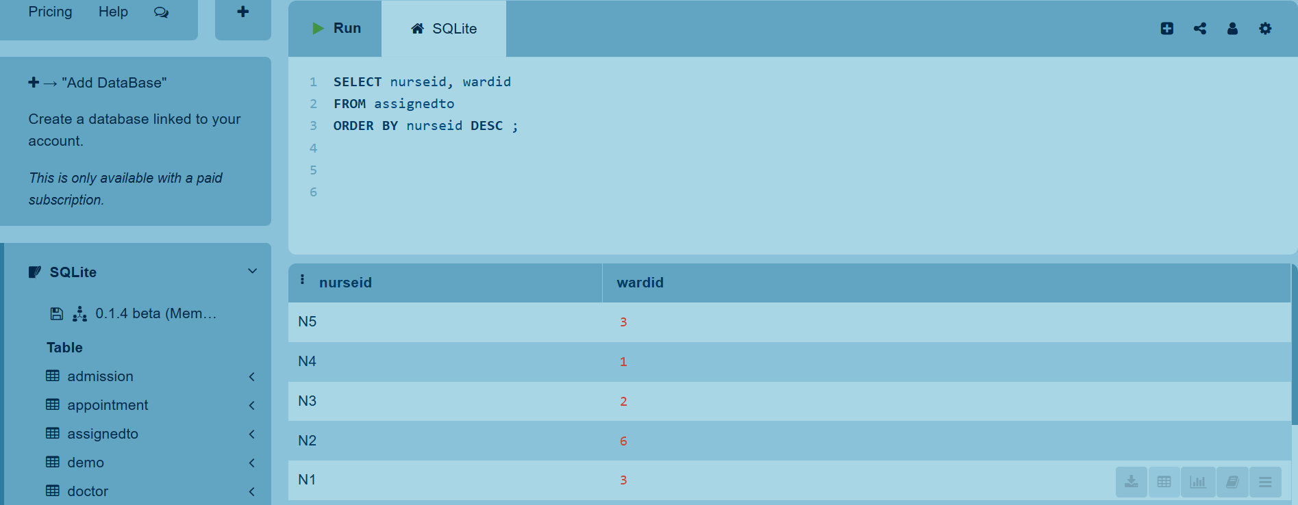
13.Retrieve the nurse id and the corresponding ward id.The results are sorted by nurse id in descending order, meaning nurses with higher IDs appear first

Slide 43
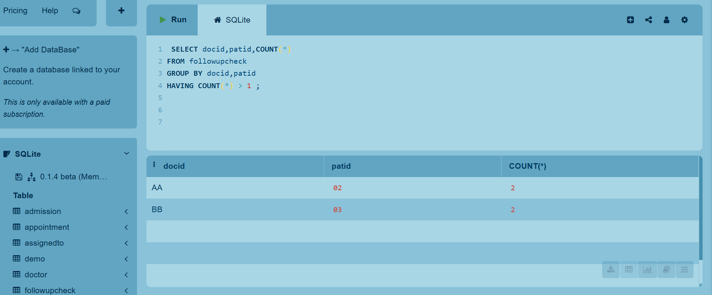
14.Consider the groups of followupcheck where each group contains the followupchecks that are from the same patients supplied by the same doctor.For each group that has more than one followupcheck ,retrieve the doc id,pat id and nr of followupchecks in the group

Slide 44
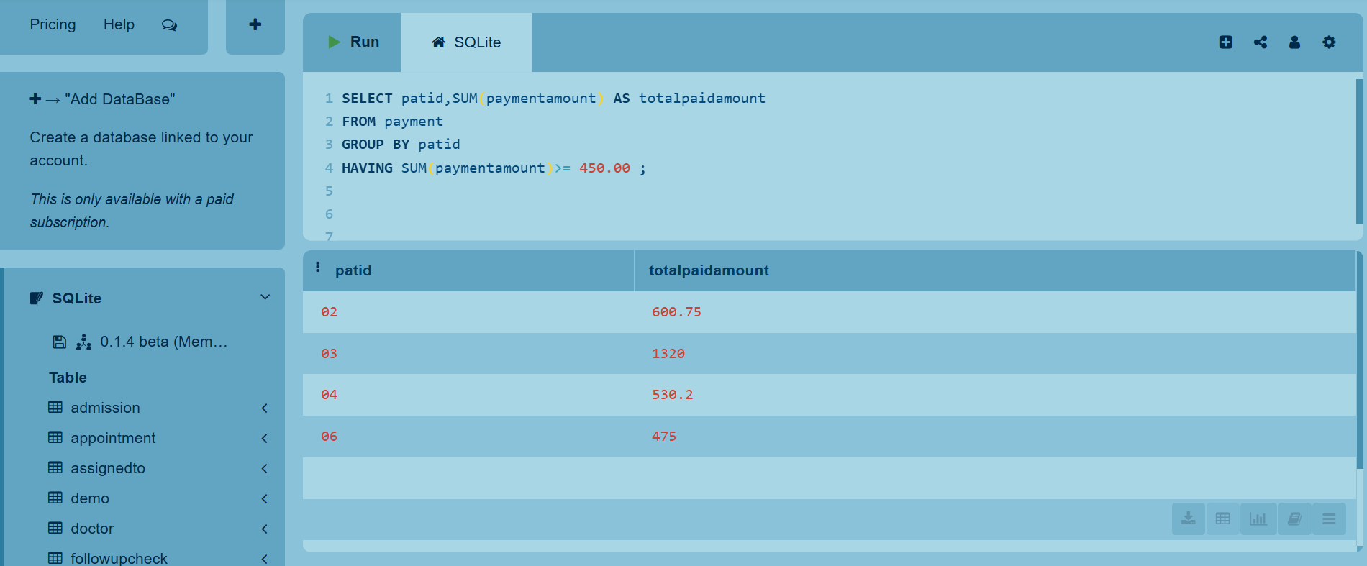
15.For each patient having a total payment greater than 450.00,retrieve the patid and the total payment amount for each patient

Slide 45
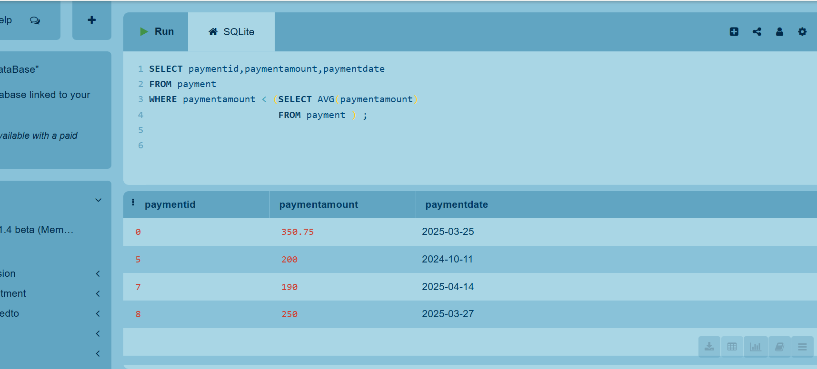
16.For each payment whose payment amount is below the average payment,retreive the payment id,payment amount,payment date

Slide 46
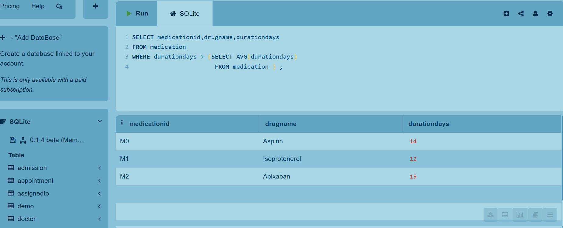
17.For each medication whose duration days is higher than the average duration days,retrieve the medication id,drug name,duration days

Slide 47
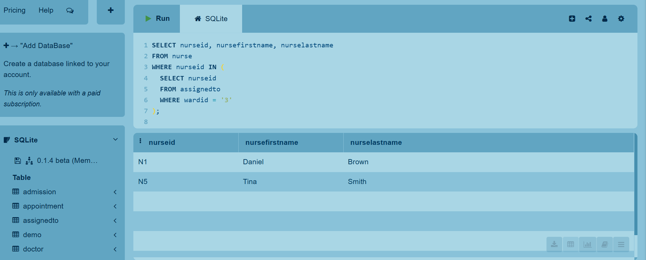
18.For each nurse which is assigned to ward with ID 3,retrieve nurse id, nurse first name, nurse last name

Slide 48
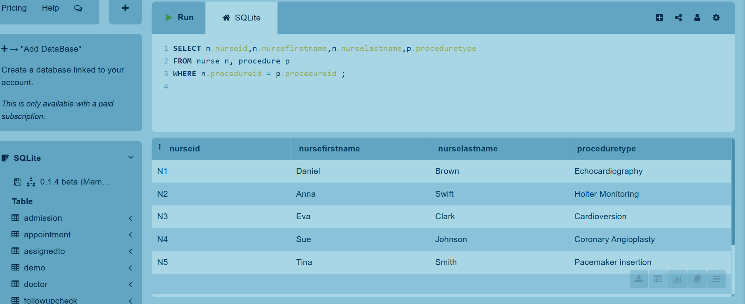
19.For each nurse,retreive the nurse id,nurse first name, nurse last name and procedure name

Slide 49
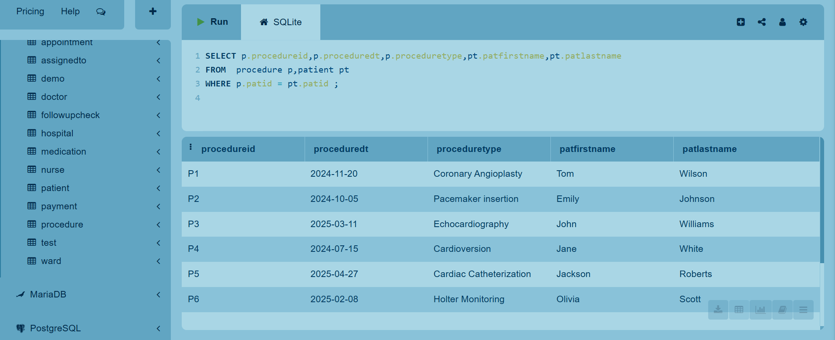
20.For each procedure,retrieve the procedure id,procedure date,procedure type,patient name,patient last name

Slide 50
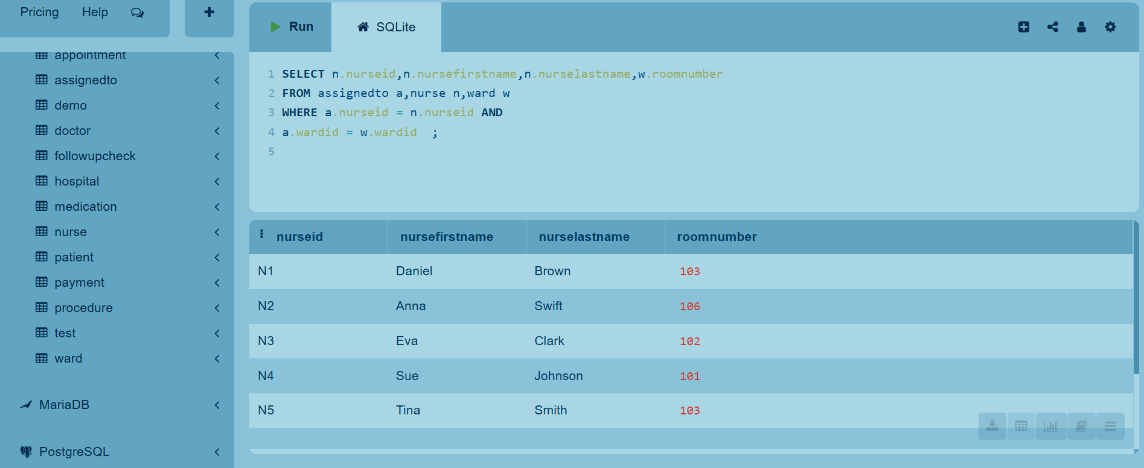
21.For each nurse assignment, retrieve the nurse ID, first name, last name, and the room number of the ward they are assigned to

Slide 51
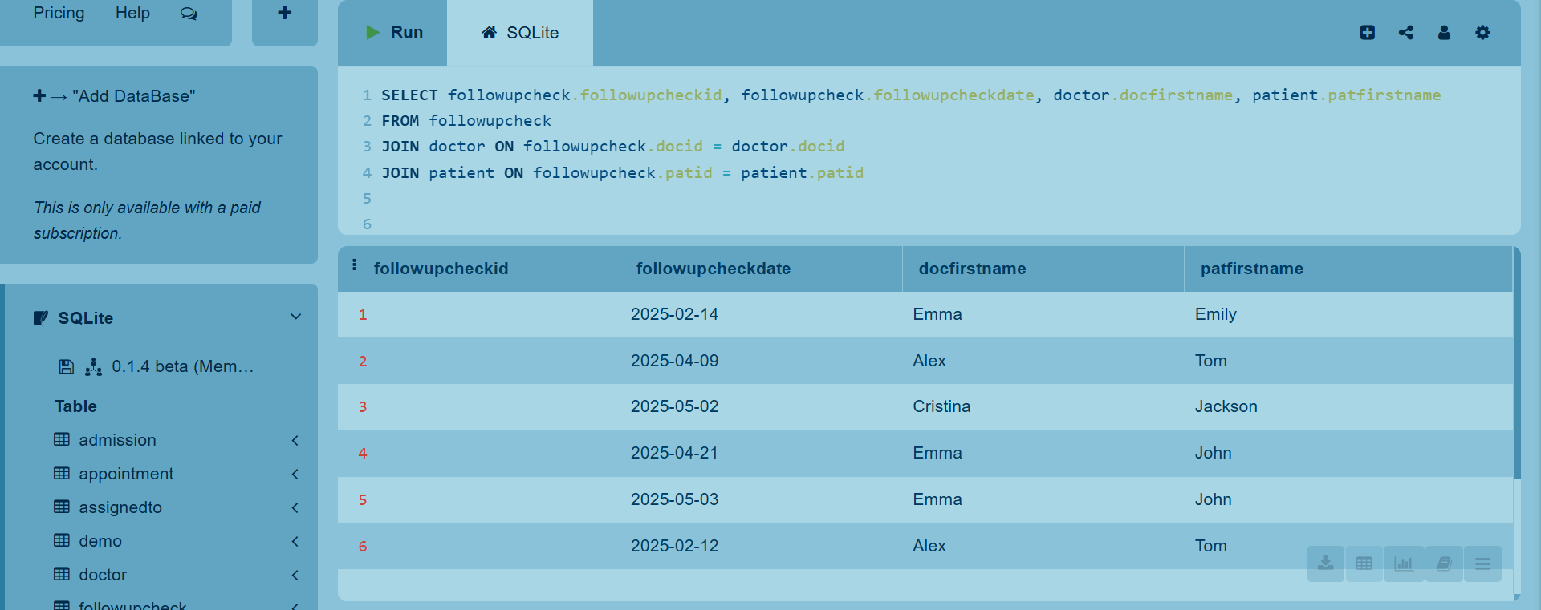
22.List all follow-up checks with doctor and patient names

Slide 52
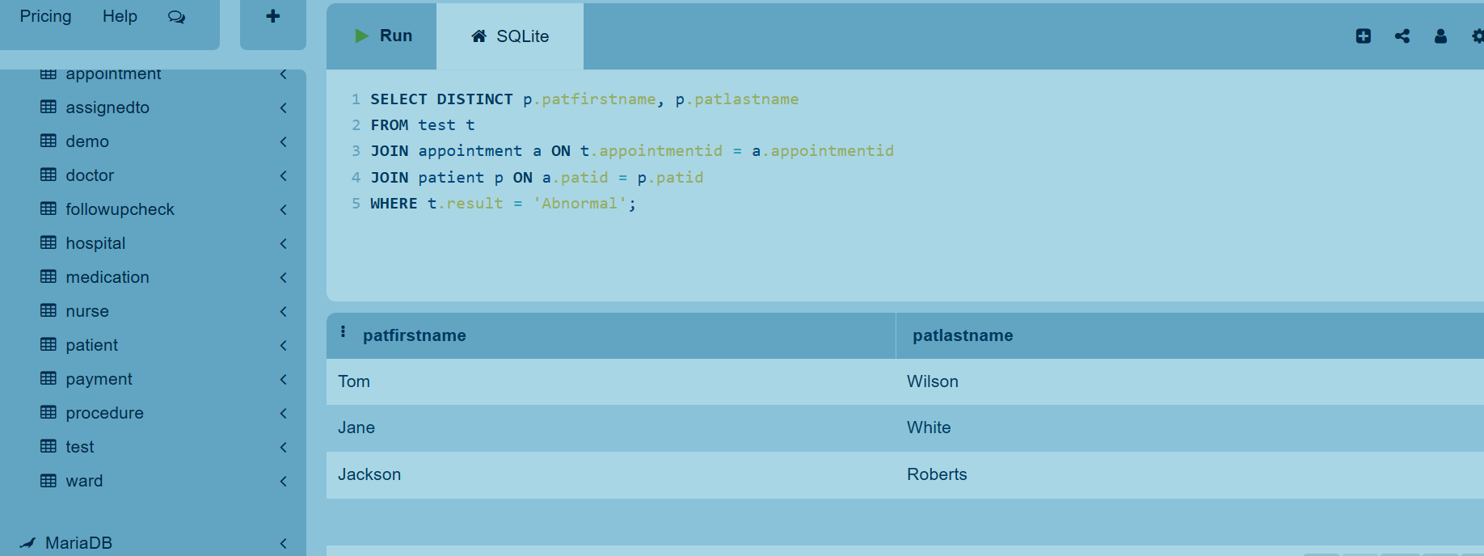
23.Retrieve the patient first name,patient last name for the patients who had a test with abnormal result

Slide 53
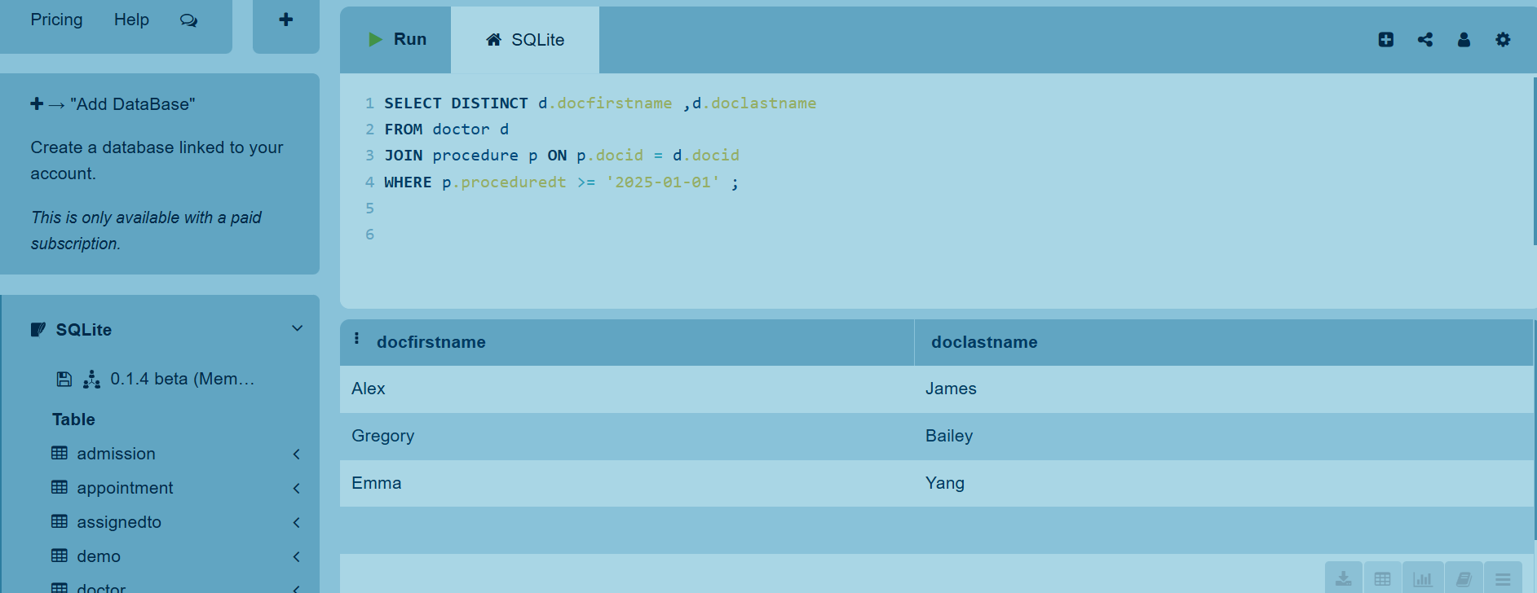
24.Retrieve the doc first name and last name for doctors who performed procedures in 2025

Slide 54
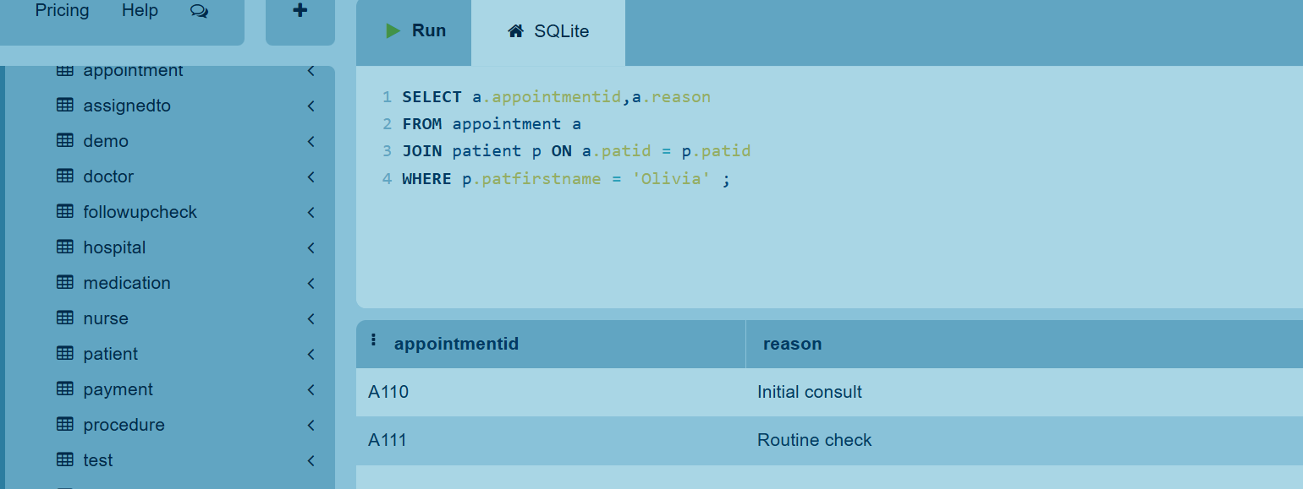
25. Find all the appointment ids and appointment reasons for patient 'Olivia'

Slide 55


THANK YOU FOR YOUR TIME!
WORKED: Meriklesta Hasanaj
Siera Kurpali
Aldis Saliasi

